Slide 1
Traumi del retroperitoneo: limiti diagnostici e terapeutici.
Dott. Paolo Locurto
AOPU «G. Martino» Messina
UOC Chirurgia Generale ad indirizzo oncologico
Direttore: Prof. G. Navarra

Slide 2
Dott. Paolo Locurto

Slide 3
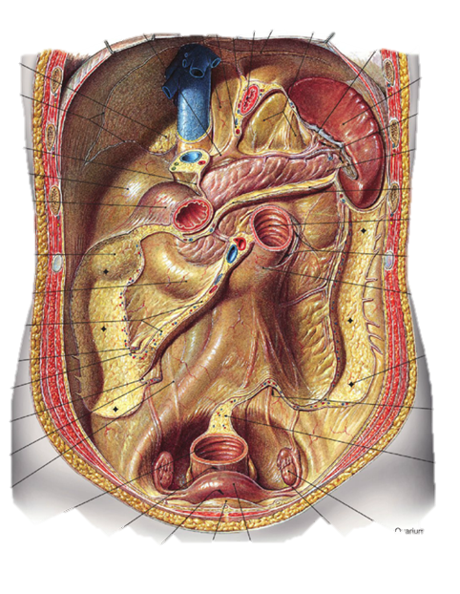
The retroperitoneal space is a Virtual Anatomic Space, lies posterior to the sac of the peritoneal cavity and contains completely or envelops anteriorly a number of visceral and vascular structures in the gastrointestinal, genitourinary, vascular, musculoskeletal, and nervous systems.
Dott. Paolo Locurto

Slide 4
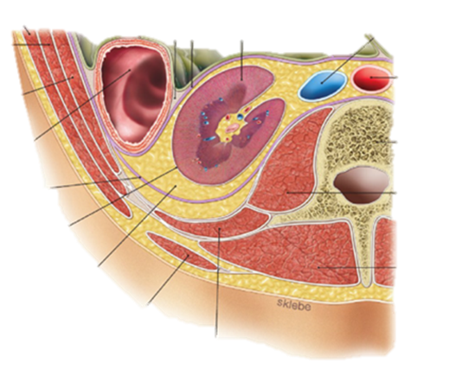
Toldt
Acquisito: origina dal mesogastrio dorsale embrionario fuso con il peritoneo posteriore parietale primitivo (fascia di Toldt)
Vero:
pararenale anteriore,
sovra-mesocolico dx e sx
sottomesocolico dx e sx
perirenale
pararenale posteriore dx e sx
Gerota
Zuckerkandl
Dott. Paolo Locurto

Slide 5
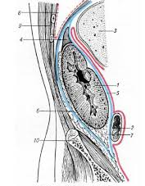
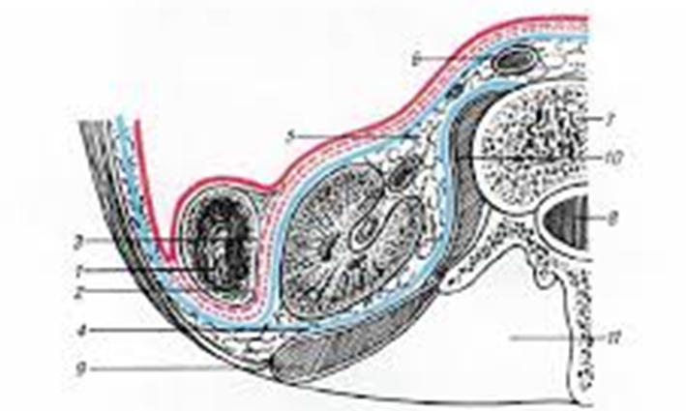
Dott. Paolo Locurto

Slide 6
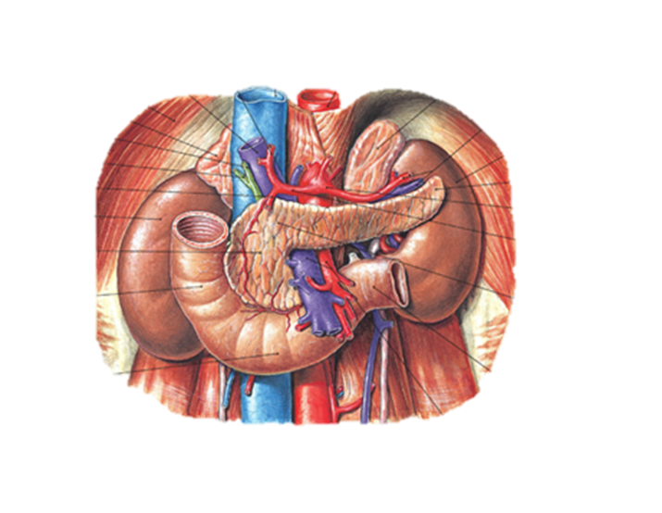
Injury to gastrointestinal structures such as the
distal esophagus,
the second, third, and fourth portions of the duodenum,
the pancreas,
the posterior parts of the ascending and descending colon
rectum
Injury to genitourinary structures such as the
kidneys,
adrenal glands,
ureters,
bladder
Dott. Paolo Locurto

Slide 7
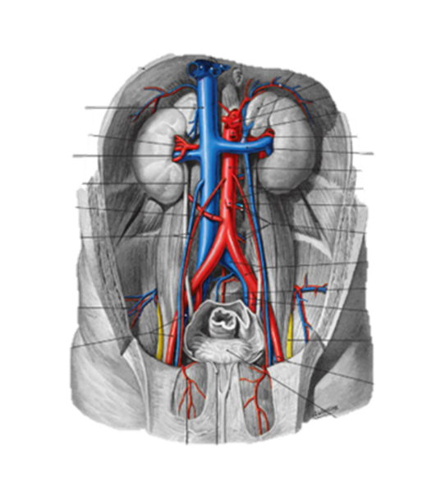
Injuries to musculoskeletal structures such as the
psoas major,
quadratus lumborum,
iliacus muscles,
the diaphragm, and the
vertebral bodies from penetrating wounds or the
pelvic bones
Injury to vascular structures such as the
abdominal aorta and
inferior vena cava and their branches or
retroperitoneal branches of the portal venous system
Dott. Paolo Locurto

Slide 8
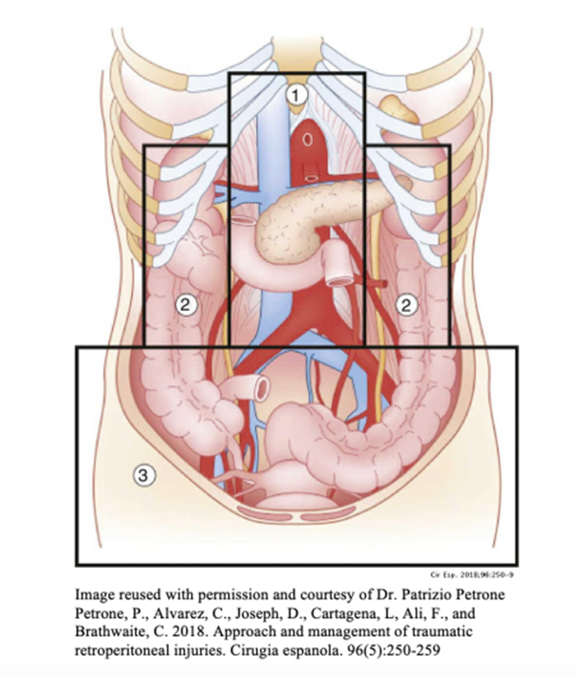
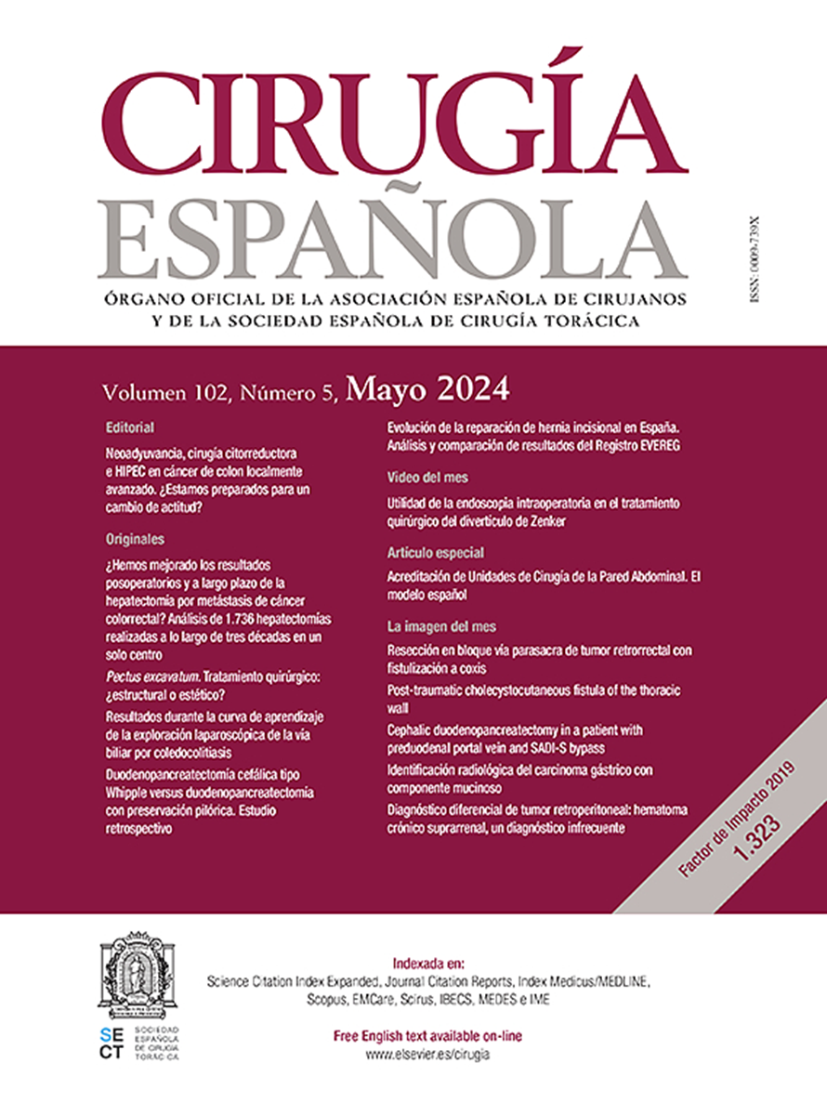
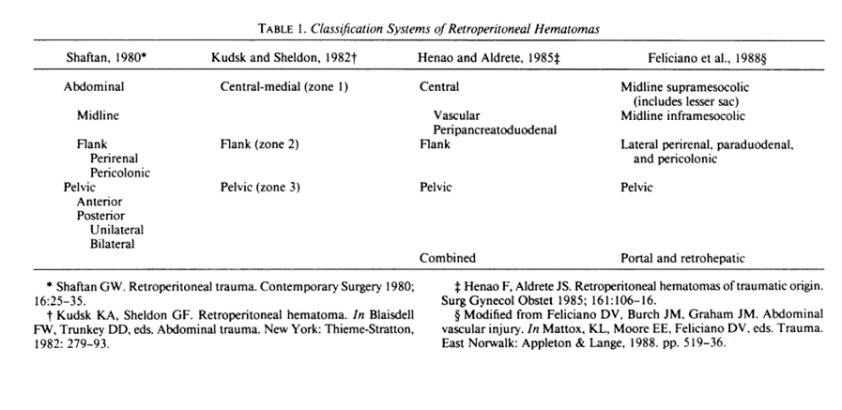
c i r e s p . 2 0 1 8 ; 9 6 ( 5 ) : 2 5 0 – 2 5 9
Dott. Paolo Locurto

Slide 9
Dott. Paolo Locurto

Slide 10
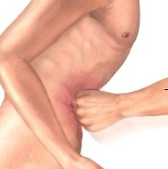
Mechanism of Injury
The mechanism of injury in patients suffering blunt trauma is best described as a moving or stationary victim striking or being struck by a moving or stationary object or surface. Any of these mechanisms will cause sudden contact with compression, deceleration with deformation, or both." The magnitude of injuries that occur is related to the kinetic energy of the victim at the time of impact.
Direct contact may lead to contusions, lacerations, avulsions, or ruptures, while deceleration may avulse the vein or its branches or disrupt the intima of the artery with secondary thrombosis.
Blunt rupture of the second or third portion of the duodenum presenting as a periduodenal retroperitoneal hematoma is thought to be secondary to a direct blow with compression or shearing against the spine or a closed loop blowout from deceleration. In patients with midline retroperitoneal hematomas from blunt trauma, deceleration with avulsion of small branches from the aorta, inferior vena cava, superior mesenteric artery, or portal vein beneath the pancreas is the most common cause

Slide 11
Blunt trauma
Penetrating trauma
Injuries occur nearly exclusively in severe polytrauma, when high energy force is applied to the upper abdomen, crushing the retroperitoneal structures against the vertebral bodies.
In adults about 60% of injuries are caused by motor vehicle accidents and consequent impact with the steering wheel (seat belt).
In children the most common mechanism is a direct blow to the epigastrium from bicycle handlebars.
In a stab wound, the weapon damages the tissue along the tract of injury.
In a gunshot wound, the passage of the projectile and the associated pressure waves cause a wider area of injury.
After penetrating trauma, concomitant injuries of the: Stomach, major vascular structures, liver, colon, spleen, kidney, and duodenum
Javier Casillas. Multidisciplinary Teaching Atlas of the Pancreas. Radiological, Surgical, and Pathological Correlations. Springer 2016
Dott. Paolo Locurto

Slide 13
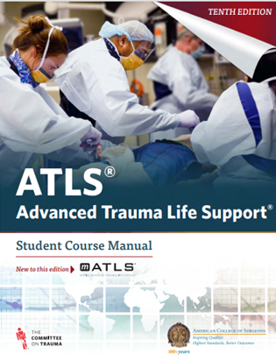
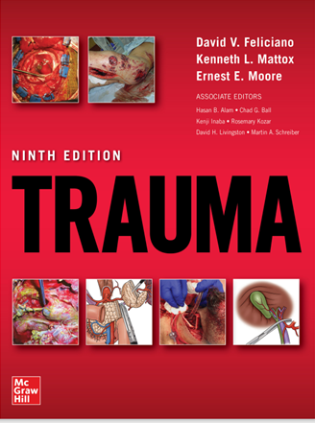
➢ Patients with blunt injuries who are hemodynamically stable and without peritonitis or associated abdominal injuries can be managed non-operatively (NOM).
➢ CT scan with IV should be performed to identify and assess the severity of blunt trauma and evaluate associated injuries, to determine if NOM is wise.
J Trauma Acute Care Surg. 2018 Mar;84(3):517-531
Dott. Paolo Locurto

Slide 14
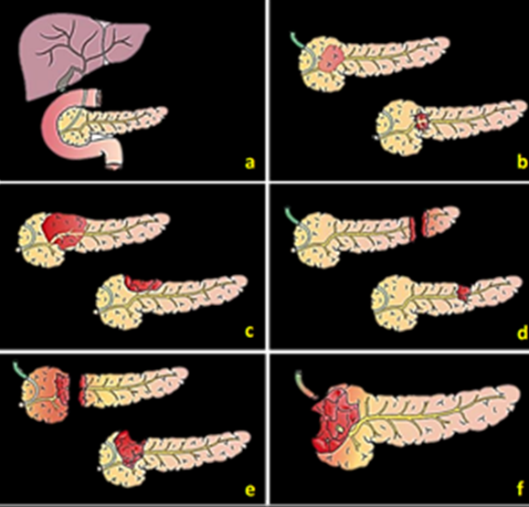
NOM for pancreatic injuries
Grading and diagnosis of main ductal injury are key factors in the decision making [GoR C; LoE II];
Contrast-enhanced CT scan performed during the portal venous phase is the diagnostic modality of choice in blunt abdominal trauma patients to diagnose pancreatic injury. CT scan is not sensitive for detecting main ductal injury [GoR C; LoE II];
Magnetic resonance cholangiopancreatography (MRCP) represents the first choice for evaluation of duct injury if appropriate [GoR C; LoE II];
ERCP is the most sensitive technique to detect a main ductal injury and allows simultaneous treatment [GoR C; LoE II]
J Trauma Acute Care Surg. 2018 Mar;84(3):517-531
Dott. Paolo Locurto

Slide 15
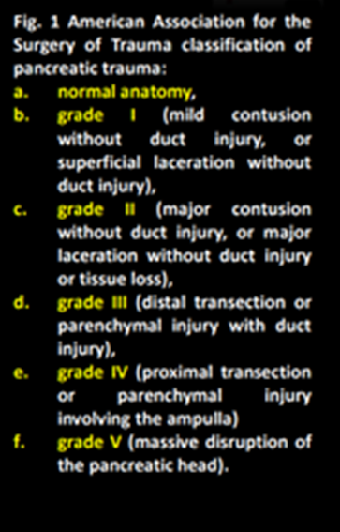
In grade I/II pancreatic injuries NOM has low morbidity [GoR C; LoE II];
For grade III/IV pancreatic injuries, OPERATIVE MANAGEMENT is RECOMMENDED, as NOM contributes to treatment delays and increases complications [GoR C; LoE II].
The treatment of complications:
• pseudocyst,
• persistent pancreatic fistula,
• peripancreatic fluid collections, may be possible with endoscopic or percutaneous drainage [GoR C; LoE II];
J Trauma Acute Care Surg. 2018 Mar;84(3):517-531
Dott. Paolo Locurto

Slide 16
Dott. Paolo Locurto

Slide 17
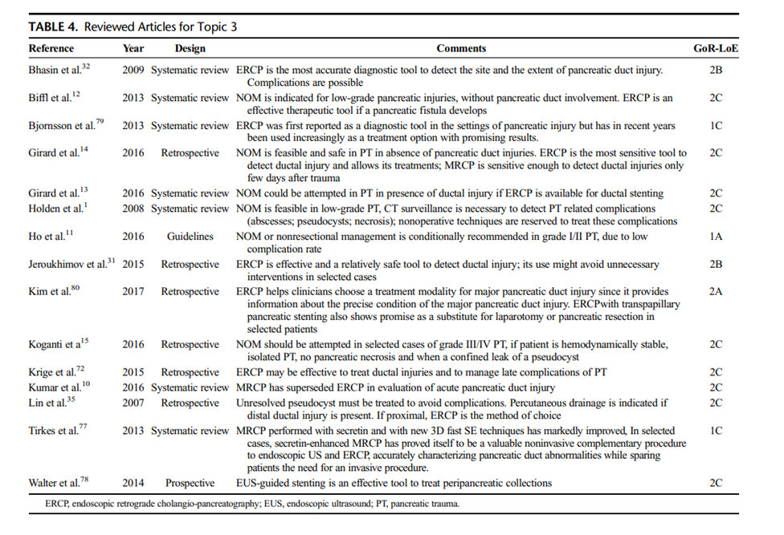
Dott. Paolo Locurto

Slide 18
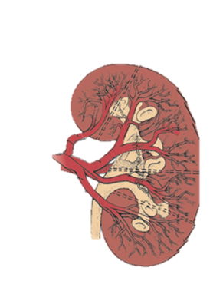
NOM for kidney injuries
Contrast-enhanced CT scan, including an EXCRETORY PHASE, is the imaging modality of choice in diagnosing and grading renal injury in patient with suspicion of kidney/urinary tract injury [GoR B; LoE I];
Angiography and selective embolization (SAE) may be used and repeated if necessary to manage renal parenchymal injury [GoR B; LoE I];
Hemodynamically stable grade IV kidney injuries can be managed by NOM in most cases. Most urinary leaks heal spontaneously [GoR C; LoE I];
A persistent urinary leak is an indication for intervention [GoR C; LoE I];
Treatment options for urinary leak include open surgery, nephrostomy or ureteral stenting. Less invasive treatment locally available is the preferred [GoR C; LoE I].
Traumatic renal artery thrombosis or dissection might be treated when warm ischemia time is less than 4 hours, but it is associated with high rate of kidney loss [GoR C; LoE II]
J Trauma Acute Care Surg. 2018 Mar;84(3):517-531
Dott. Paolo Locurto

Slide 19
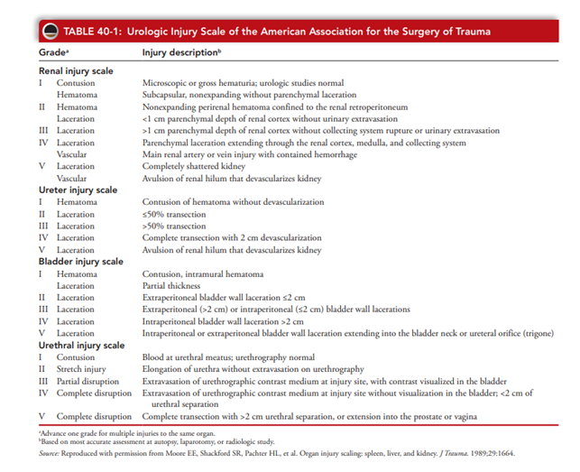
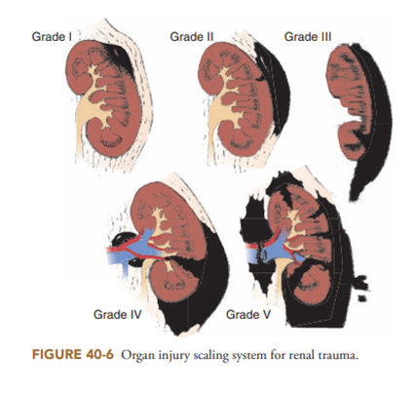
Dott. Paolo Locurto

Slide 20
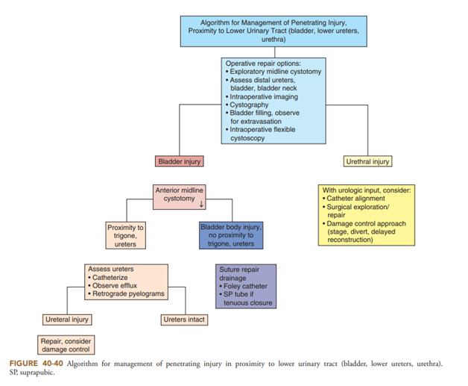
Dott. Paolo Locurto

Slide 21
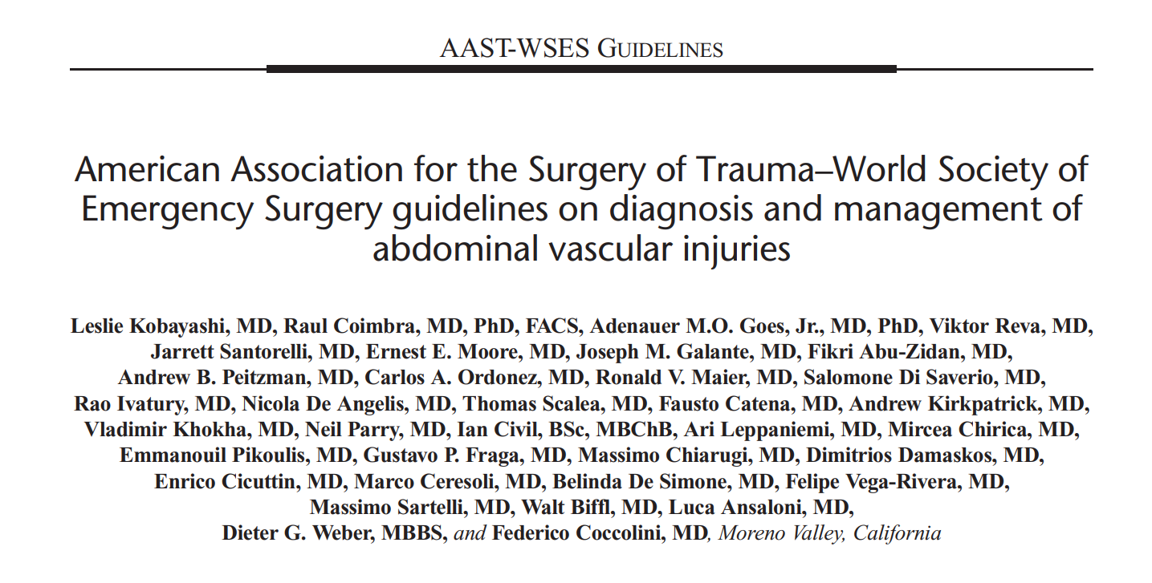
J Trauma Acute Care Surg Volume 89, Number 6. 2020
Dott. Paolo Locurto

Slide 22
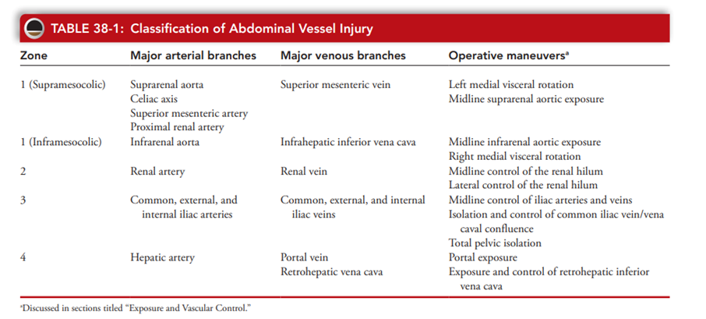

Slide 23
J Trauma Acute Care Surg Volume 89, Number 6. 2020
Dott. Paolo Locurto

Slide 24
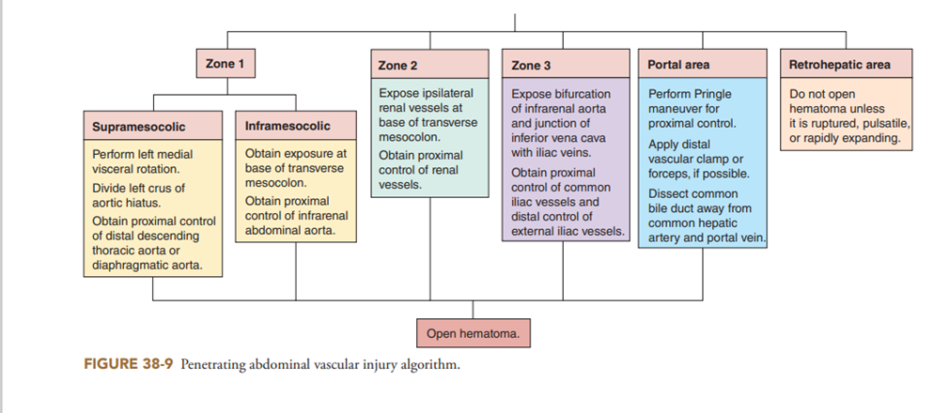
Dott. Paolo Locurto

Slide 25
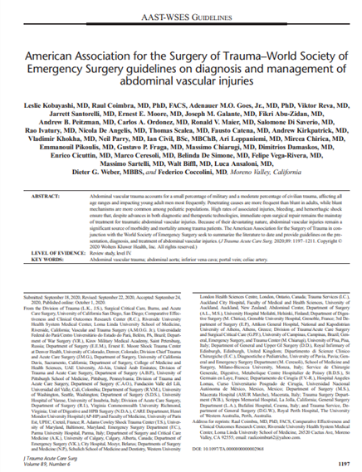
Clinical Presentation and Diagnosis of AVI
• Hemodynamically (HD) unstable trauma patients with signs of abdominal or pelvic trauma and peritonitis should be suspected to have major AVIs until proven otherwise. (GoR 1B)
• Ultrasound imaging is a simple and noninvasive method for detection of intra-abdominal fluid but has poor accuracy related to major AVIs. (GoR 1B)
• Computed tomography angiography (CTA) assessment is recommended for screening stable trauma patients who do not require immediate laparotomy but who have signs of intra-abdominal injury. (GoR 1A)
• Preperitoneal pelvic packing supplemented with angiography is recommended for hemodynamic instability associated with severe pelvic fractures without another significant source of bleeding. (GoR 1A)
• The presence of pelvic contrast extravasation seen on CTA may also indicate the need for angiography and pelvic embolization. (GoR 1A)
•
J Trauma Acute Care Surg Volume 89, Number 6. 2020
Dott. Paolo Locurto

Slide 26
Operative Management of AVI
• Hemodynamically unstable trauma patients with suspicion of AVI should be taken immediately to the operating room for exploration, hemorrhage control, and resuscitation. (GoR 1B)
• During laparotomy all retroperitoneal hematomas resulting from penetrating trauma should be explored. (GoR 1B)
• All zone 1 hematomas regardless of mechanism of injury should be explored. (GoR 1B)
• Zone 2 hematomas due to blunt mechanisms of injury should undergo operative exploration only if expanding. (GoR 1B)
• Stable zone 3 hematomas after blunt trauma should be observed. Expanding hematomas due to blunt trauma associated with pelvic fracture should undergo preperitoneal packing, angioembolization, or both in sequence. (GoR 1C)
• Where available, REBOA with zone 3 deployment should be considered in transient responders and HD unstable patients with pelvic injury to augment the effect of preperitoneal packing and allow resuscitation before definitive operative or endovascular control. (GoR 2C)
J Trauma Acute Care Surg Volume 89, Number 6. 2020
Dott. Paolo Locurto

Slide 27
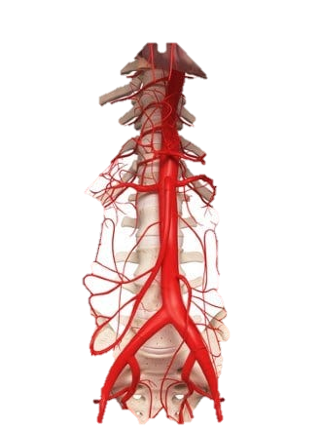
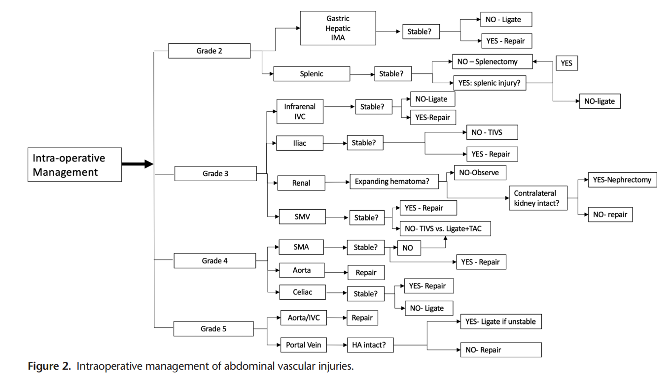
Dott. Paolo Locurto

Slide 28
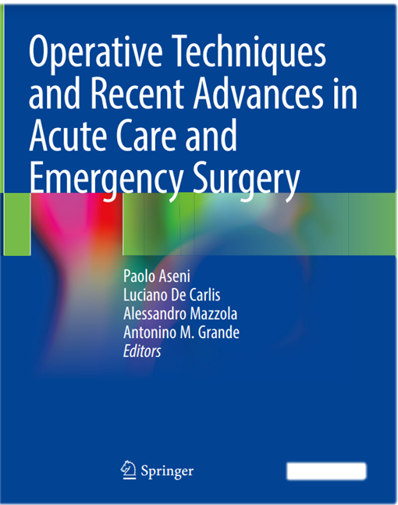
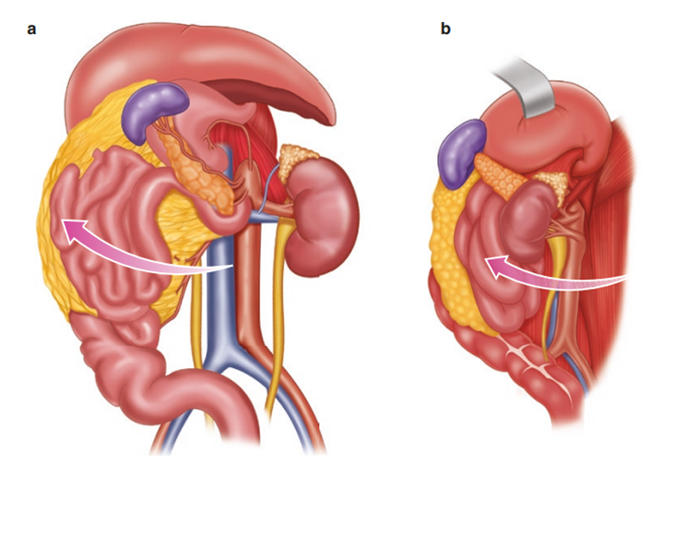
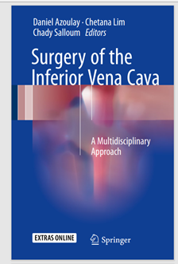
Dott. Paolo Locurto

Slide 29
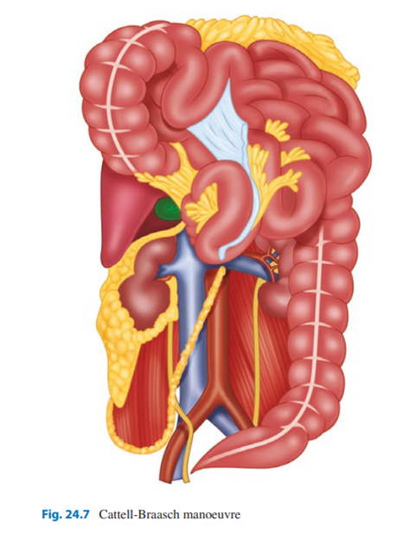
Dott. Paolo Locurto

Slide 30
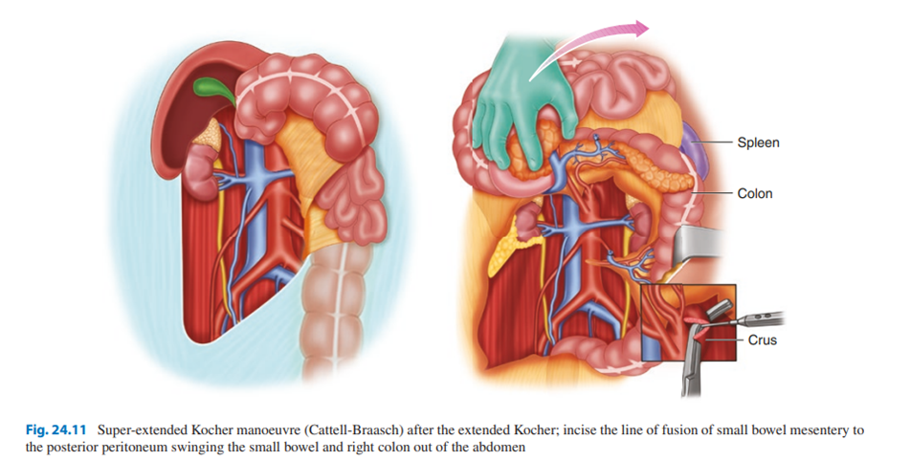
Dott. Paolo Locurto

Slide 31
Dott. Paolo Locurto

Slide 32
Dott. Paolo Locurto

Slide 33
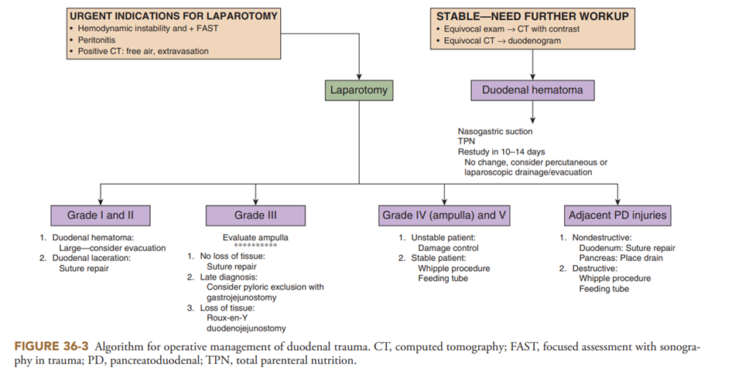
Dott. Paolo Locurto

Slide 34
Dott. Paolo Locurto

Slide 35
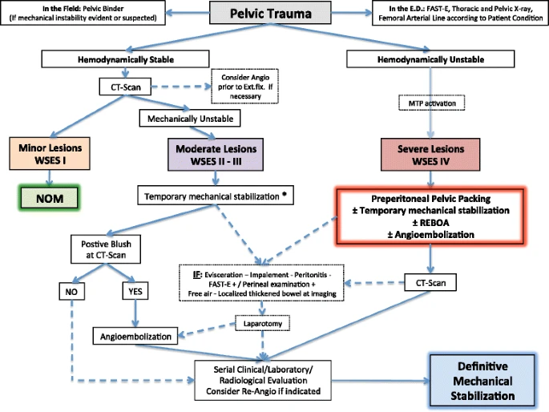
Dott. Paolo Locurto

Slide 36
Recommendations in Pelvic Trauma
The time between arrival in the Emergency Department and definitive bleeding control should be minimized to improve outcomes of patients with hemodynamically unstable pelvic fractures [Grade 2A].
Serum lactate and base deficit represent sensitive diagnostic markers to estimate the extent of traumatic-haemorrhagic shock, and to monitor response to resuscitation [Grade 1B].
The use of Pelvic X-ray and E-FAST in the Emergency Department is recommended in hemodynamic and mechanic unstable patients with pelvic trauma and allows to identify the injuries that require an early pelvic stabilization, an early angiography, and a rapid reductive maneuver, as well as laparotomy [Grade 1B].
CT-scan with 3-Dimensional bones reconstructions reduces the tissue damage during invasive procedures, the risk of neurological disorders after surgical fixation, operative time, and irradiation and the required expertise [Grade 1B].
Dott. Paolo Locurto

Slide 37
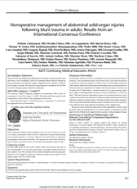
Role of Pre-peritoneal Pelvic Packing in hemodynamically unstable pelvic fractures
Patients with pelvic fracture-related hemodynamic instability should always be considered for pre-peritoneal pelvic packing, especially in hospitals with no angiography service [Grade 1C].
Direct preperitoneal pelvic packing represents an effective surgical measure of early haemorrhage control in hypotensive patients with bleeding pelvic ring disruptions [Grade 1B].
Pelvic packing should be performed in conjunction with pelvic stabilization to maximize the effectiveness of bleeding control [Grade 2A].
Patients with pelvic fracture-related hemodynamic instability with persistent bleeding after angiography should always be considered for pre-peritoneal pelvic packing [Grade 2A].
Pre-peritoneal pelvic packing is an effective technique in controlling hemorrhage in patients with pelvic fracture-related hemodynamic instability undergone prior anterior/C-clamp fixation [Grade 2A].
Dott. Paolo Locurto

Slide 38
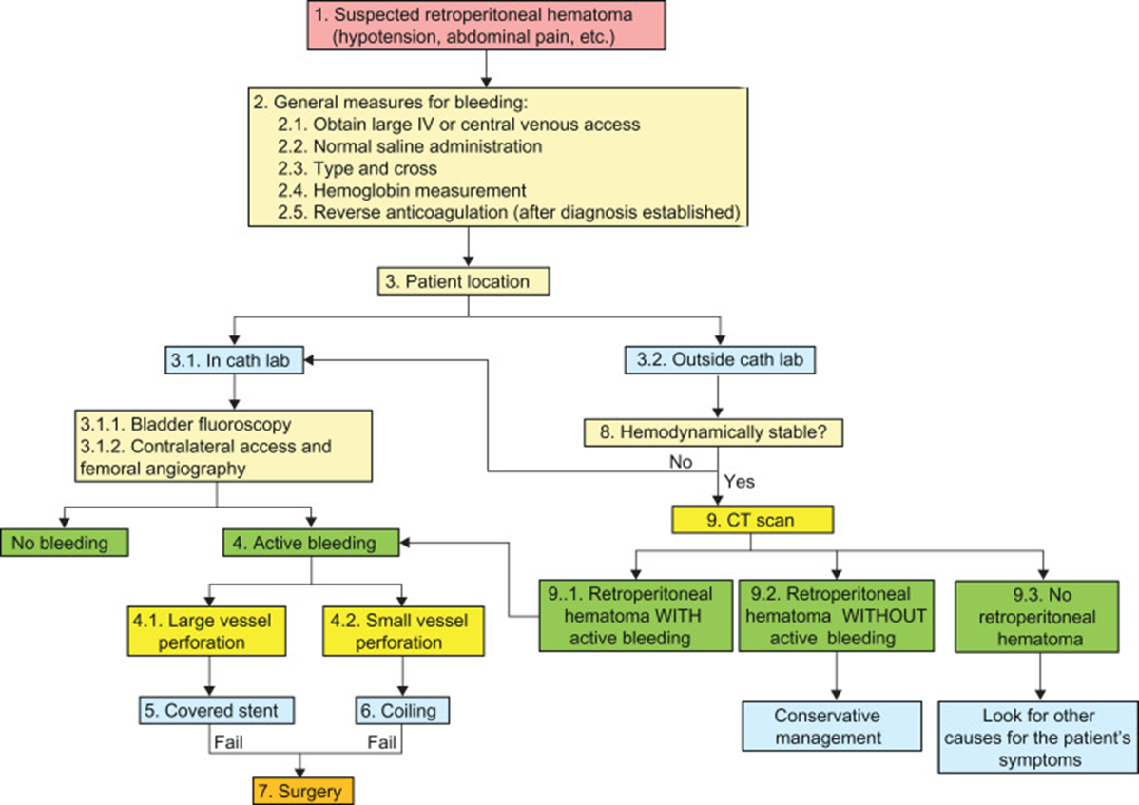
Dott. Paolo Locurto

Slide 39
Conclusions
Zone 1
The highest mortality rates are related to large vessels, so the diagnostic suspicion is essential.
The most frequent aortic injuries are infrarenal, while vena cava injuries are predominantly adrenal.
The therapeutic objectives are based on the control of hemostasis/contamination and the assessment of injuries.
In the presence of hemodynamic stability and absence of contraindication, conservative management, including angioembolization, should initially be considered. Otherwise, the use of sutures is preferable to more complex maneuvers.
Zone 2
Conservative treatment is the most widely accepted, and surgery is defined by the presence of associated injuries or instability. Within the surgical approach, conservative maneuvers are more frequent than nephrectomy or adrenalectomy.
A high index of suspicion of ureteral injuries is necessary.
Vascular reconstruction is reserved for patients with anomalies of the contralateral kidney.
Zone 3
Iliac vessel injuries prevail in importance due to their associated high mortality.
Arteriorrhaphy and venous ligation stand out, together with an increase in the use of intravascular techniques.
The management of bone injury is based on the multidiscplinary approach and individualized for each case.
Dott. Paolo Locurto

