Slide 1


IL TRAUMA EPATICO
DANIELE DEL FABBRO
Dipartimento di Chirurgia Generale
Sezione di Chirurgia d’Urgenza e del Trauma
Humanitas Research Hospital
Rozzano (MI)
Ai sensi dell’art. 76, comma 4, dell’Accordo Stato-Regioni del 2 febbraio 2017 e del paragrafo 4.5 del manuale nazionale di accreditamento per l’erogazione di eventi ECM. DICHIARA che negli ultimi due anni non ha avuto, rapporti con soggetti portatori di interessi commerciali in ambito Sanitario.

Slide 2
Epidemiology and clinical assessment
Diagnosis
Treatment
Results

Slide 3
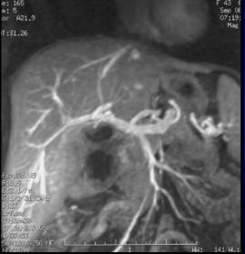
Large and heavy
RUQ
Partially protected
Blood flow - dual blood supply
Huge redundancy
Regenerative property

Slide 4
Liver is involved in 5-10% of all abdominal traumas
The right lobe is the most commonly injured portion

Slide 5
MECHANISM OF HEPATIC INJURY
Blunt Rapid deceleration
falls, traffic accidents
rupture of Glisson’s capsule and/or parenchymal fractures
venous and/or arterial bleeding, bile duct disruption, devitalised segments/lobes/liver
Penetrating Direct trauma
gunshot, stab or impalement injuries
minimal parenchymal disruption, venous and/or arterial bleeding, bile duct division, devitalised liver rare

Slide 6
BLUNT TRAUMAS: Spleen 26,6%
Kidney 24,2%
Liver 16,2%
Intestine 15,2%
Abdominal wall 3,6%
Retrop. Hematoma 2,7% Mesentery 2,5%
Pancreas 1,4%
Diaphragm 1,1%

Slide 7
Prevalence of solid organ injuries
blunt + penetrating abdominal traumas
 | MILZA | FEGATO | RENE | TOT
STRADA | 35% | 25% | 12% | 72%
LAVORO | 6% | 9% | 1% | 16%
CASA | 3% | 3% | 1% | 7%
CRIMINE | 1% | 3% | 1% | 5%
Humanitas Research Hospital 2015-2021

Slide 8
Mortality: 10-20%
Time from the event to the hospital (golden hour)
Time between initial assessment and therapy
Characteristics of the hospital
Associate injuries (mortality up to 50-60%)

Slide 9
Blunt thoraco-abdominal traumas with high energy
Large caliber gunshot wounds
Greater morbidity and mortality

Slide 10
Clinical assessment
At the admission:
Primary evaluation – ABCDE → hypovolemic shock?
Liver injury should be suspected in all patients with blunt or penetrating thoracoabdominal trauma
Right upper quadrant tenderness and abdominal distention (hemoperitoneum)
E-FAST
Standard set of laboratory tests liver function tests may be normal at the beginning

Slide 11

AAST liver injury scale

Slide 12
75%
<10%

Slide 13

2020
Hemodynamic instability: admission systolic blood pressure is < 90 mmHg with clinical evidence of hemorrhagic shock with skin vasoconstriction (cool, clammy, decreased capillary refill), altered level of consciousness and/or shortness of breath, or > 90 mmHg but requiring bolus infusions/transfusions and/or vasopressor drugs and/or admission base excess (BE) > -5 mmol/l or transfusion requirement of at least > 4 units of packed red blood cells within the first 8 h.
A grade of liver injury does not necessarily define treatment, higher grade injuries have higher mortality and are at greater risk of failing non-operative management.

Slide 14
Epidemiology and clinical assessment
Diagnosis
Treatment
Results

Slide 15
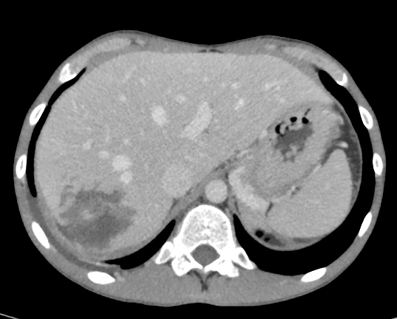
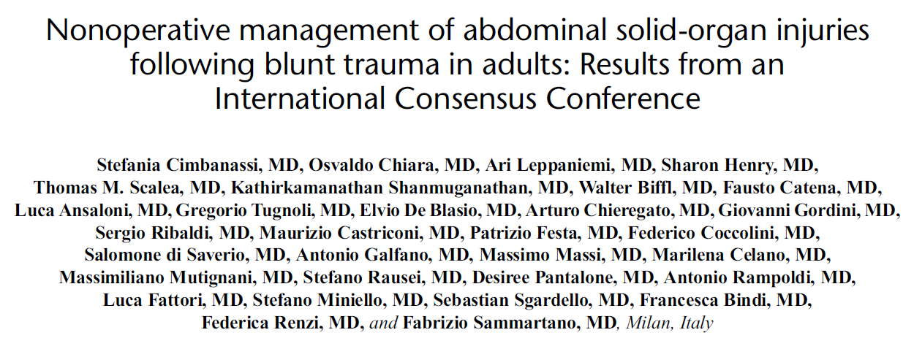

CT scan with iv contrast should be performed to
identify and assess the severity of liver injury
evaluate associated injuries
A routine repeated imaging is not necessary unless there are clinical or laboratory signs of complications
2017

Slide 16
2017
1/6 grade I traumas were missed on CEUS
2/7 grade II traumas were diagnosed as grade I and III
1/7 grade III traumas were diagnosed as grade II
The two examinations had a good level of concordance (P<0.0001)

Slide 17
2017
Significant differences in the AST, ALT, and LDH concentrations and AST/ALT ratio before and after liver trauma (P<0.05)
No significant difference in ALP or GGT

Slide 18
Epidemiology and clinical assessment
Diagnosis
Treatment
Results

Slide 19
CASE SCENARIO 1
34y M, motorbike accident, stable after initial fuid resuscitation (bolus of 250 + 250 ml crystalloids)
CT findings:
  grade 3 liver injury
  grade 3 right kidney injury
  grade 2 splenic injury
  vertebral and pelvic fracture
Addressed for Angiography and Embolization

Slide 20
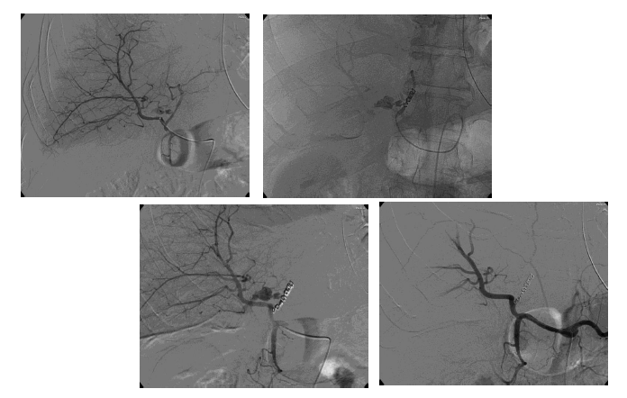
AE of left hepatic artery…

Slide 21
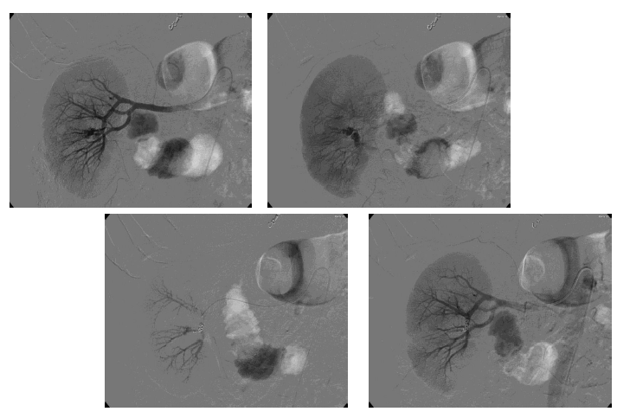
…and right kidney

Slide 22
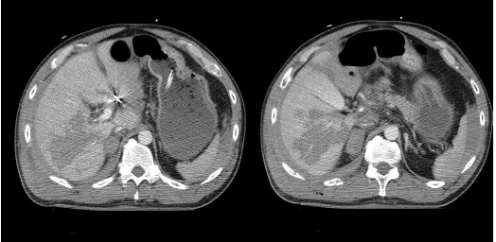
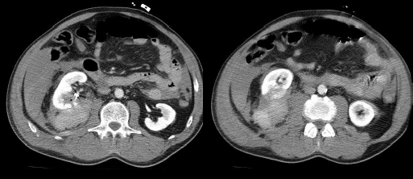
After first AE: anemization, increase of hemoperitoneum

Slide 23
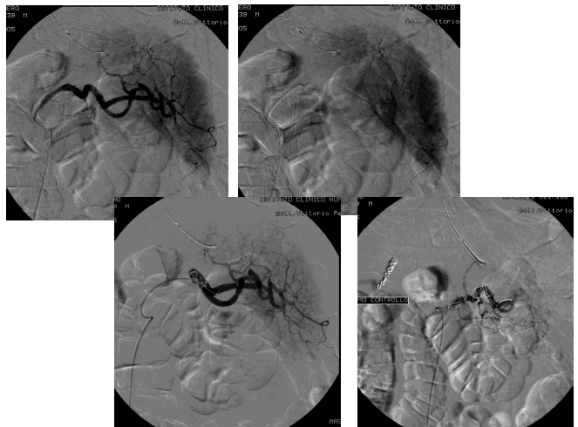
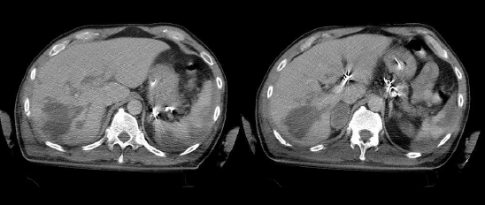
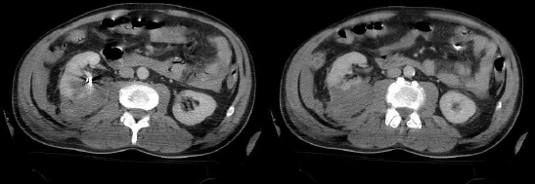
Spleen embolization…
Stabilized

Slide 24
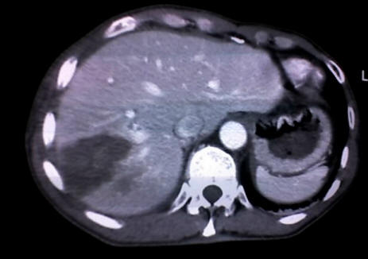
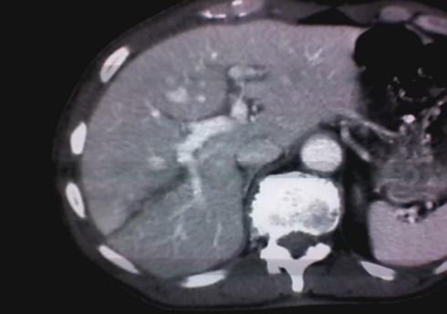
NOM IN LIVER INJURIES
50%-57% of liver trauma
Sherman HF, J Trauma 37:616, 1994
Meredith JW, J Trauma 36:529, 1994
Croce MA, Am Surg 221:774, 1995
85% of liver trauma
(successful 96% of cases)
Velmahos GC, Arch Surg 138:475, 2003

Slide 25

2020

Slide 26
Hemodynamically unstable patients Operative management
Pringle maneuver
Manual compression
Peri-hepatic packing
AVOID major hepatic resections at first!

Slide 27
CASE SCENARIO 2
29y, M, crush trauma at work
BP 90/40 pH 7,05
HR 150 Lac 7,3
RR 20 BE – 13,7
SpO2 90% Hb 13,4
E-FAST: free fluid in all scans

Slide 28
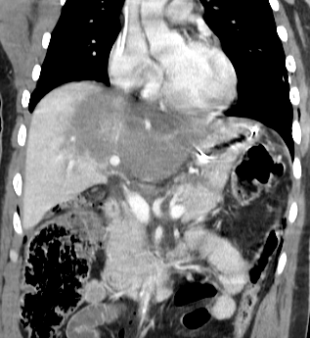
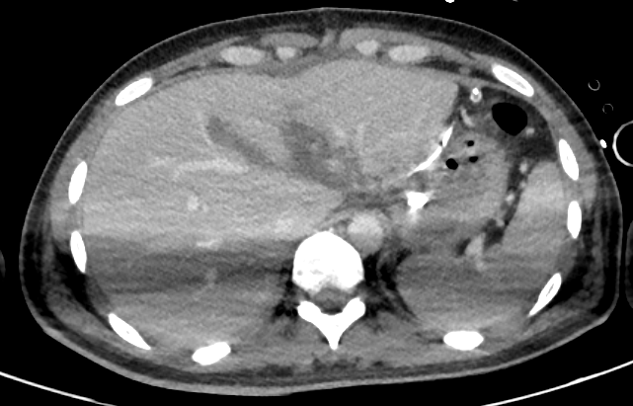
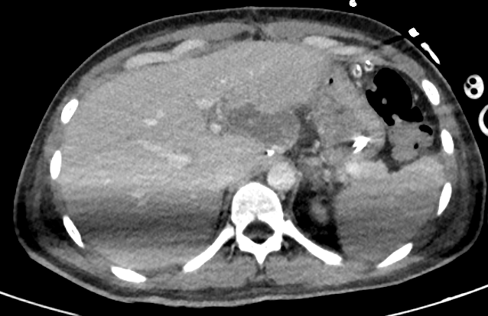
Post-depacking
10 days later

Slide 29
Epidemiology and clinical assessment
Diagnosis
Treatment
Results

Slide 31
212 patients with liver injuries
181 patient uderwent NOM:
6 primary angioembolization
12 selective embolization for delayed bleedings
NOM failure in 6 cases
The overall success rate of NOM was 96.7% (175/181)

Slide 32
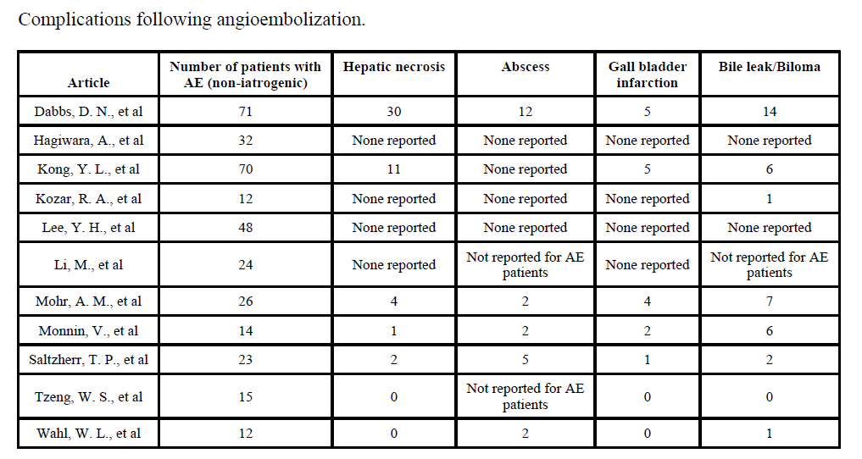
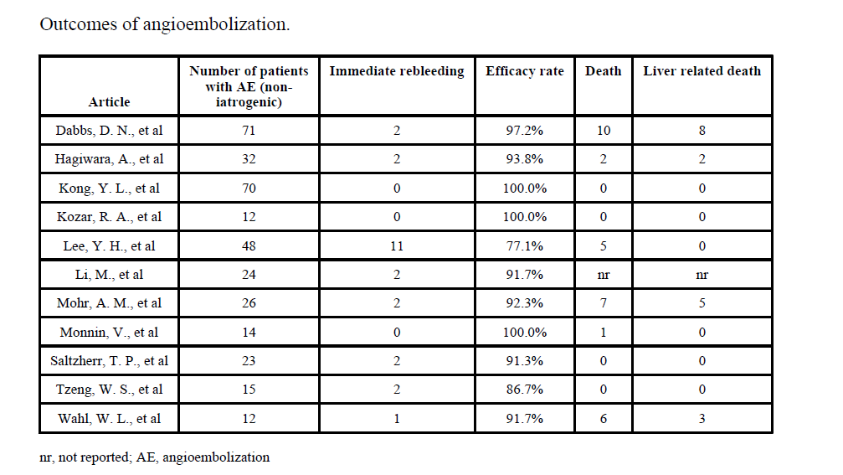
998 patients
347 embolized
AE success rate 77–100%
Weighted average efficacy rate 93%
Mortality up to 7%
Complication rate?

Slide 33
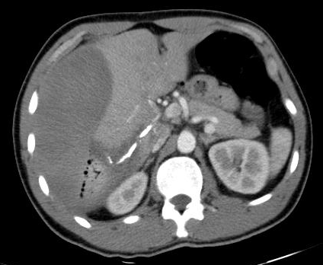
Complications in 12–14% of patients, particularly after high-grade injury
Late complications should be managed
by minimally invasive procedures
(interventional radiology / endoscopy)

Slide 34
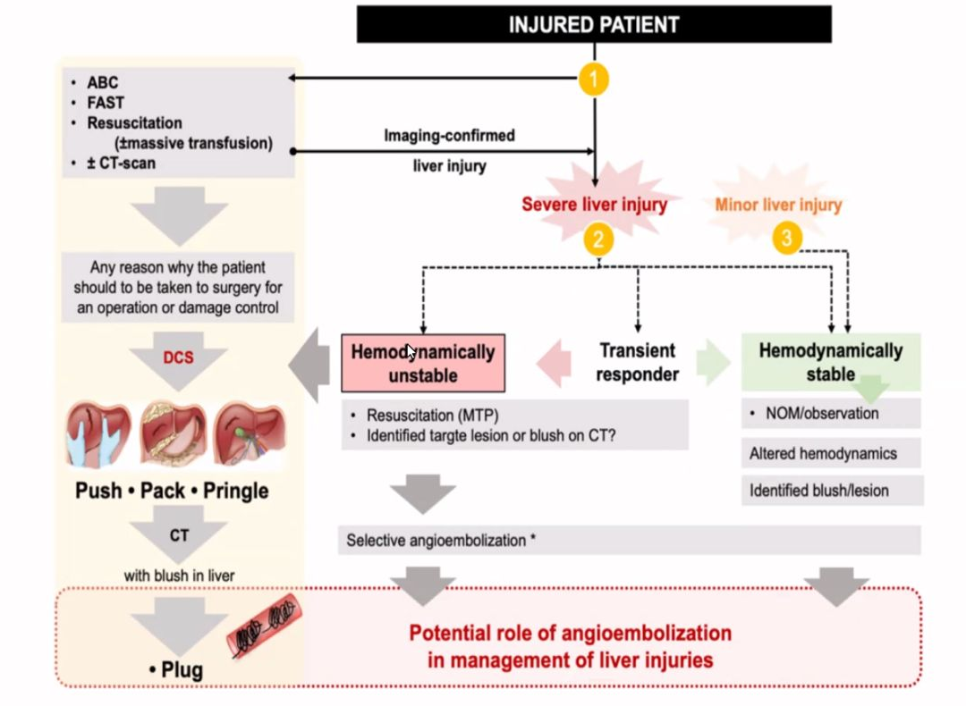
CONCLUSIONS (1)
Liver trauma
management algorythm

Slide 35
2015
CONCLUSIONS (2): NOM
80-90% of blunt liver injuries receive non-operative management, in hemodynamically stable patients in absence of other lesions requiring surgery
Angioembolization may be considered as a first-line intervention in stable patients with arterial blush on CT scan; is effective but not risk-free
There are no RCT of NOM versus operative management in high grade blunt hepatic injury
In penetrating injuries, very selective role for NOM

Slide 36

Thank you

Slide 37


