Slide 1
8-9 Giugno 2024 – Cefpas, Caltanissetta “3° Congresso nazionale sulla Gestione del trauma di interesse chirurgico. L'approccio all'evento trauma del giovane chirurgo” Presidente del Congresso: Dott. Giovanni Di Lorenzo Presidente Onorario: Dott. Giovanni Ciaccio
Ai sensi dell’art. 76, comma 4, dell’Accordo Stato-Regioni del 2 febbraio 2017 e del paragrafo 4.5 del manuale nazionale di accreditamento per l’erogazione di eventi ECM. DICHIARA che negli ultimi due anni non ha avuto, rapporti con soggetti portatori di interessi commerciali in ambito Sanitario.

Slide 2
ERAS IN TRAUMA AND EMERGENCY SURGERY:
IS IT FEASIBLE?
Dott. Marco Scatizzi
Direttore S.O.C. Chirurgia Generale
Ospedale S. Maria Annunziata e
Ospedale Serristori
Firenze - USL Toscana Centro

Slide 3
Enhanced Recovery After Surgery
Enhanced Recovery After Surgery (ERAS) is a multidisciplinary structured approach which provides standardized evidence-based components of care to patients undergoing specific types of surgery.
A list of guidelines are drawn up and updated by the ERAS Society®
Notes:
3

Slide 4
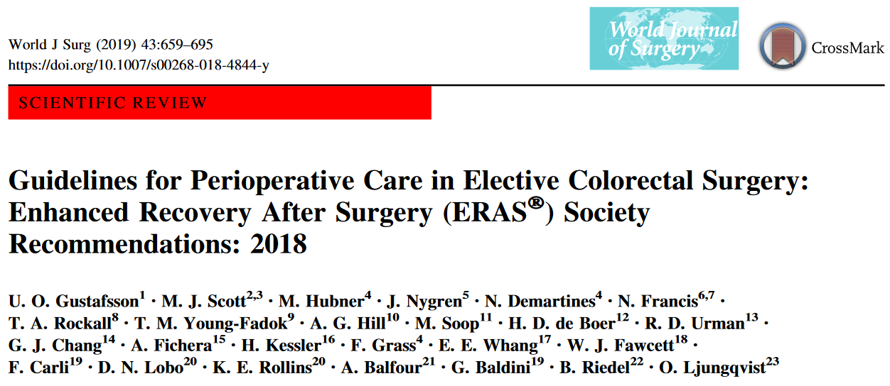
Notes:
4

Slide 5
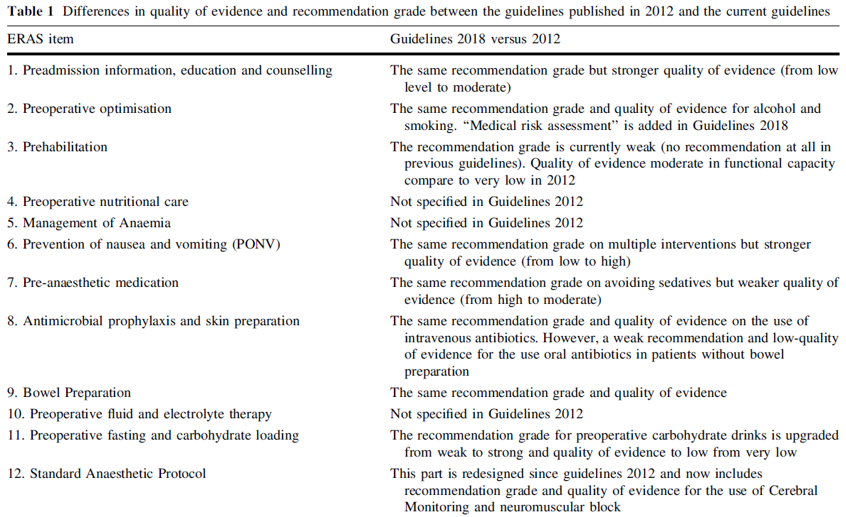
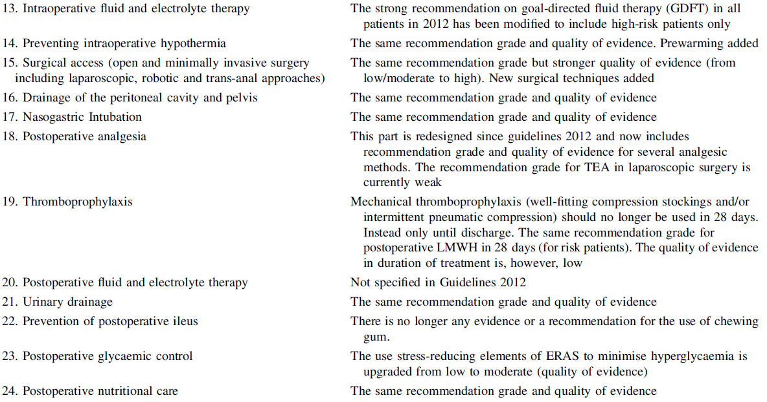
ERAS ITEMS 2018 vs 2012

Slide 6
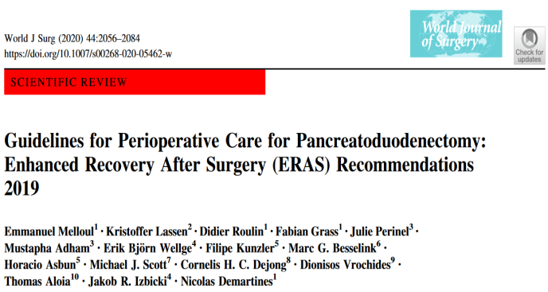
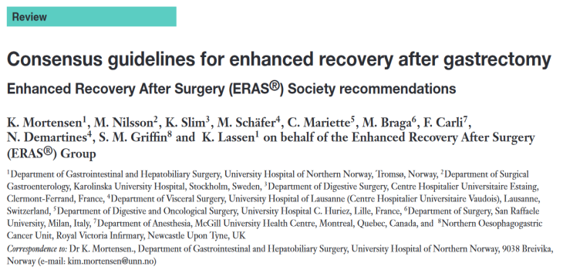
ERAS: NEW ITEMS & NEW FIELDS
Notes:
6

Slide 7
WHAT ABOUT THE EMERGENCY SETTING?
Notes:
7

Slide 8
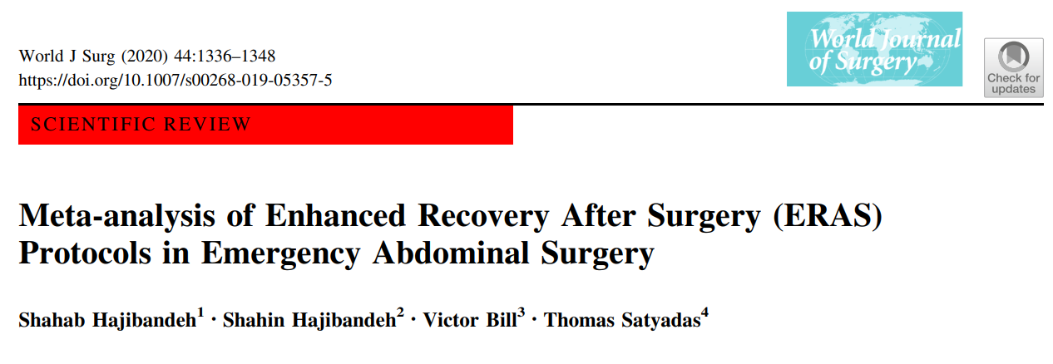
Primary outcomes
• Length of hospital stay
• Total post-operative complications
Secondary outcomes
• Post-operative time to first flatus
• Post-operative time to first defecation
• Post-operative time to first oral liquid diet
• Post-operative time to first oral solid diet
Major complications
• Pulmonary complications
• Paralytic ileus
• Surgical site infection
• 30-Day mortality
• Need for re-admission
• Need for re-operation
6 comparative studies, 1334 patients:
690 ERAS;
644 standard care.
Emergency abdominal procedures:
emergency resection of small bowel;
segmental colectomy;
total colectomy;
operation for perforated viscus;
adhesiolysis or laparotomy.
Notes:
8

Slide 9
Primary outcomes
ERAS protocols resulted in shorter length of
hospital stay compared with non-ERAS
protocols (meandifference: -3.09,
95% CI -3.37,-2.80, P <0.00001).
ERAS protocols resulted in lower risk of total
post-operative complications compared
with non-ERASprotocols (odds ratio: 0.50,
95% CI 0.38, 0.66,P <0.00001)
Notes:
9

Slide 10
Secondary outcomes
mean difference: -1.40, P<0.00001
mean difference: -2.30, P <0.00001
mean difference: -1.21,P = 0.02
mean difference: -2.40, P< 0.00001
ERAS protocols resulted in shorter time to first...
Notes:
10

Slide 11
Secondary outcomes
odds ratio: 0.60, P = 0.0008
odds ratio:0.53, 0.88, P = 0.01
odds ratio: 0.38, P = 0.0003
odds ratio: 0.39, P = 0.0001
ERAS protocols resulted in lower risk of...
Notes:
11

Slide 12
Secondary outcomes
ERAS protocols and non-ERAS protocols were similar in terms of...
“There should be an effort to incorporate
ERAS protocols into emergency abdominal surgery settings.”
Notes:
12

Slide 13
3 cohort studies, 818 patients:
418 ERAS
400 standard care
Notes:
13

Slide 14
Surgical outcomes
Length of hospital stay was significantly shorter in patients
receiving ERAS than that of those receiving conventional care
with the pooled MD of − 3.07 days (95% CI, − 3.91 to − 2.23).
The rate of postoperative complication was significantly lower
in patients receiving ERAS than that of those receiving
conventional care with the pooled RR of 0.78
(95% CI, 0.63 to 0.97).
Rates of 30-day readmission and mortality were comparable
between the two groups.
Notes:
14

Slide 15
Postoperative morbidities
The rate of postoperative ileus was significantly lower in
patients receiving ERAS than that of those receiving
conventional care with the pooled RR of 0.55
(95% CI, 0.33 to 0.91).
Rate of anastomotic leakage, rate of surgical site infection,
rate of 30-day reoperation were comparable between
the two groups.
Notes:
15

Slide 16
Gastrointestinal recovery
Time to pass flatus was significantly shorter in patients receiving ERAS than that of those receiving conventional care with the pooled MD of − 1.39 days (95% CI, − 1.52 to − 1.25).
Time to first defecation was also significantly shorter in patients receiving ERAS—with the pooled MD of − 0.73 days
(95% CI, − 1.40 to − 0.06).
A significantly shorter time to resume regular diet was found in the ERAS group with the pooled MD of − 2.39 days (95% CI, − 2.62 to − 2.15)
Notes:
16

Slide 17
Time to start adjuvant chemotherapy
Patient receiving ERAS had a significantly shorter time to start adjuvant chemotherapy, with the pooled MD of − 12.05
days (95% CI, − 14.76 to − 9.35).
Notes:
17

Slide 18
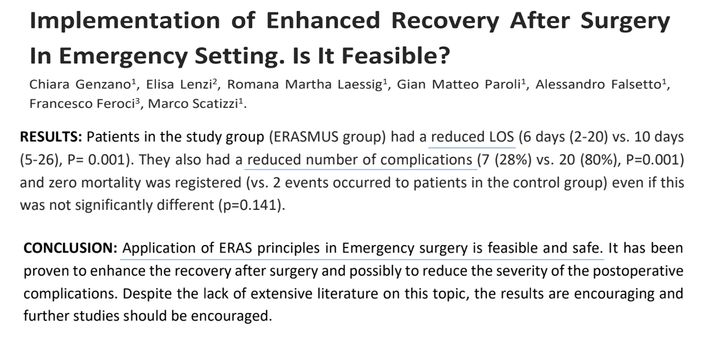
OUR EXPERIENCE:
Marzo 2020
Notes:
18

Slide 19
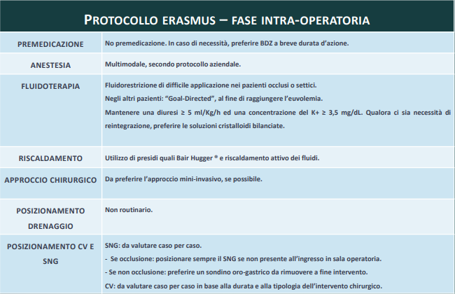
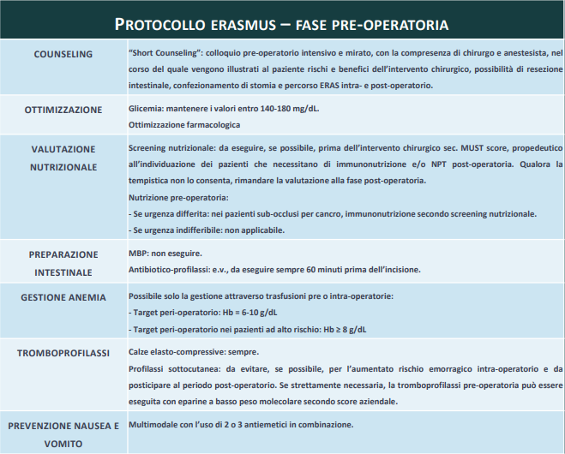
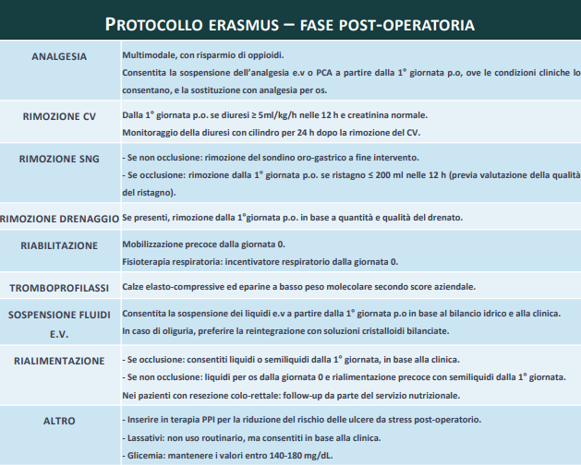
OUR EXPERIENCE:
Notes:
19

Slide 20
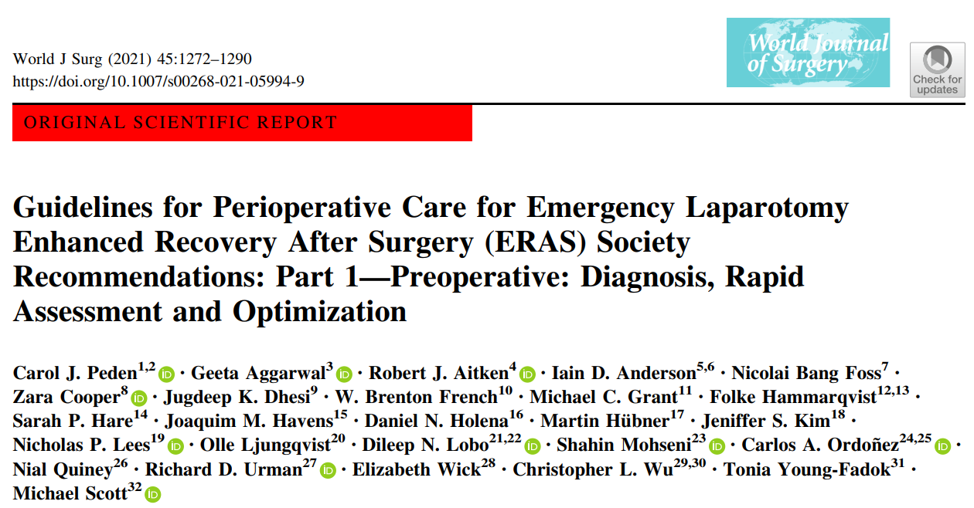
“The term ‘‘emergency laparotomy’’ encompasses a surgical exploration of the acute abdomen
for a number of underlying pathologies”.
For these ERAS Society® guidelines the term ‘‘emergency’’ is applied to all patients with a non-elective,
potentially life-threatening intra-abdominal condition requiring surgery,
excluding trauma laparotomies, vascular conditions, appendectomy, and cholecystectomy.
Notes:
20

Slide 21
Lead authors were invited by the ERAS Society to establish a guideline development group of healthcare professionals with
diverse expertise in the management of patients undergoing emergency laparotomy. The guideline development group
consisted of surgeons, anesthesiologists, and geriatricians.
The time period searched was from 2005 until mid-2020, with greater emphasis on recent publications, randomized controlled trials, systematic reviews, meta-analyses and large cohort studies
12 components of preoperative care were considered.
Notes:
21

Slide 22
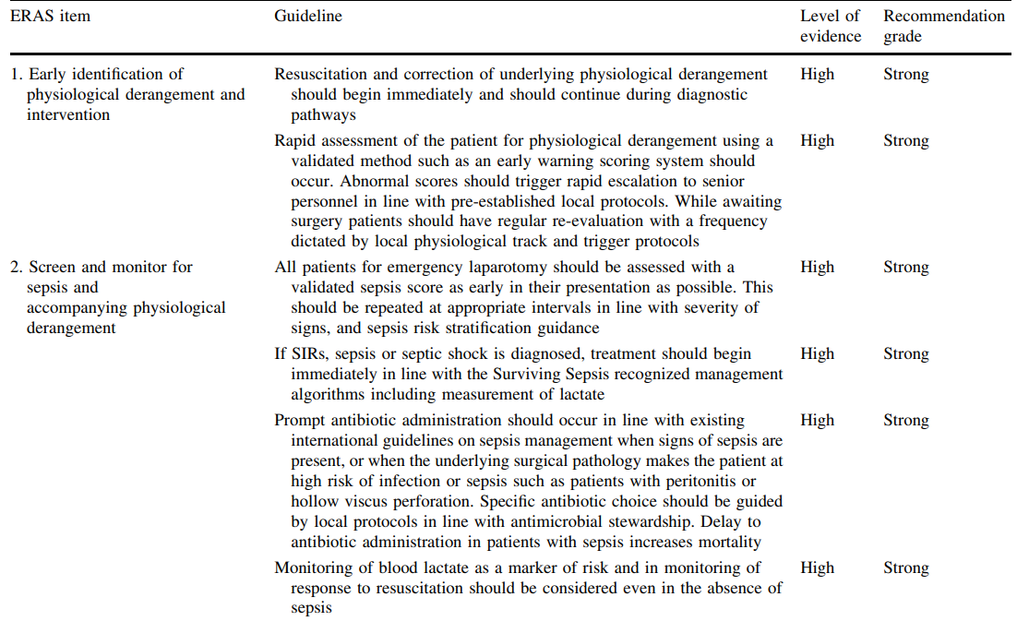
Delayed antibiotic administration increases mortality
Monitoring of blood lactate even in the absence of sepsis
Notes:
22

Slide 23
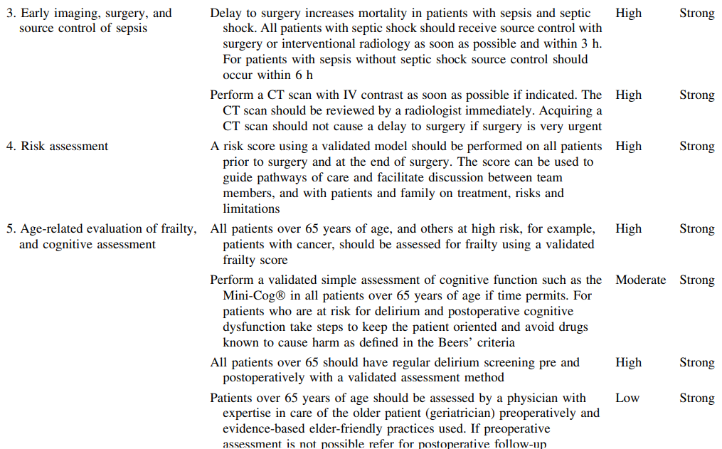
Delay to surgery increases mortality in patient with sepsis
and septic shock.
Patients with septic shock: source control within 3 h.
Patients with sepsis without septic shock: source control
within 6h.
CT scan should not cause a delay to surgery.
Notes:
23

Slide 24
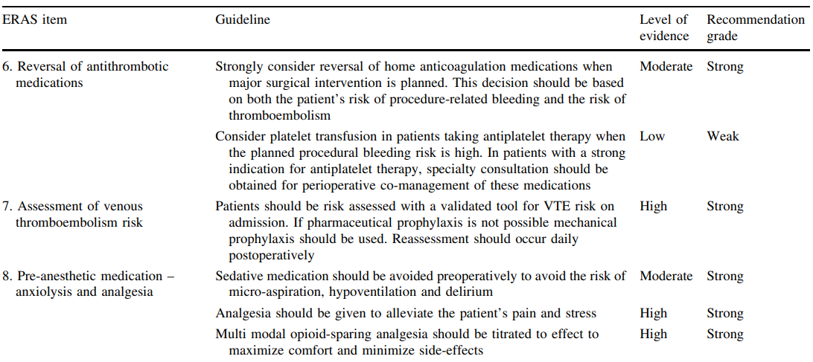
Strongly consider reversal of home
anticoagulation medications
Consider opioid-sparing analgesia
Notes:
24

Slide 25
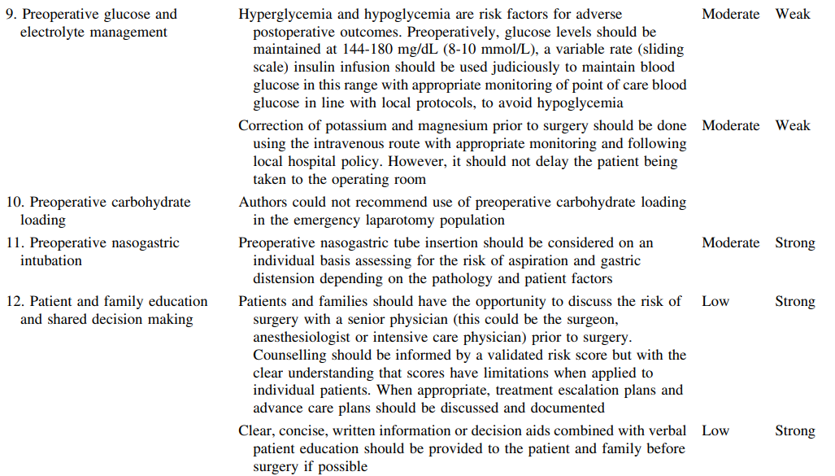
Nasogastric intubation depending on the
clinical condition.
Notes:
25

Slide 26
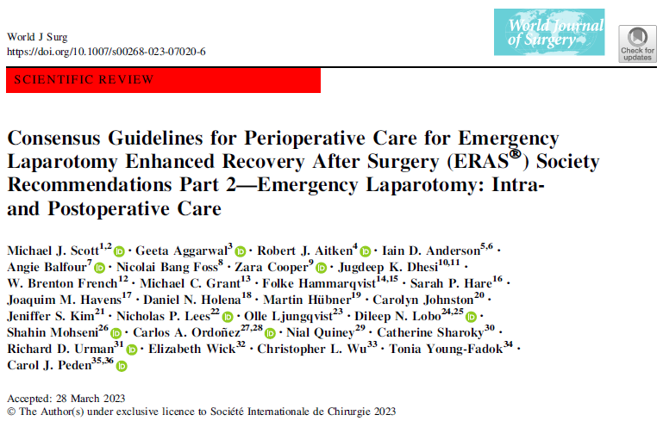

Slide 27
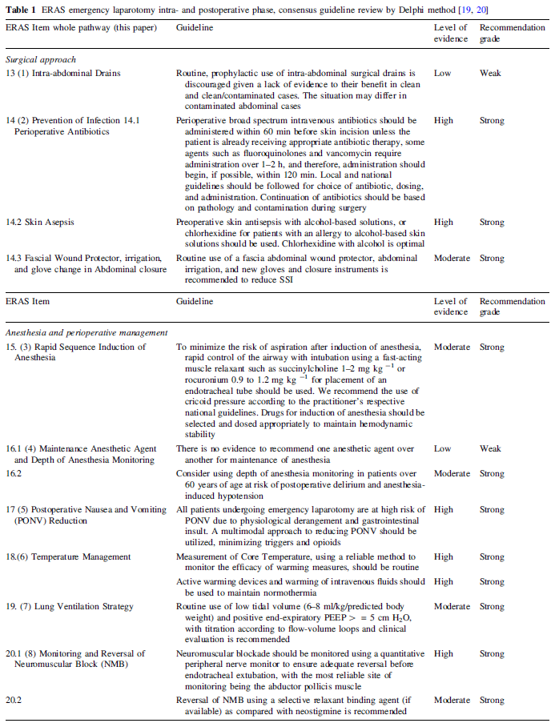
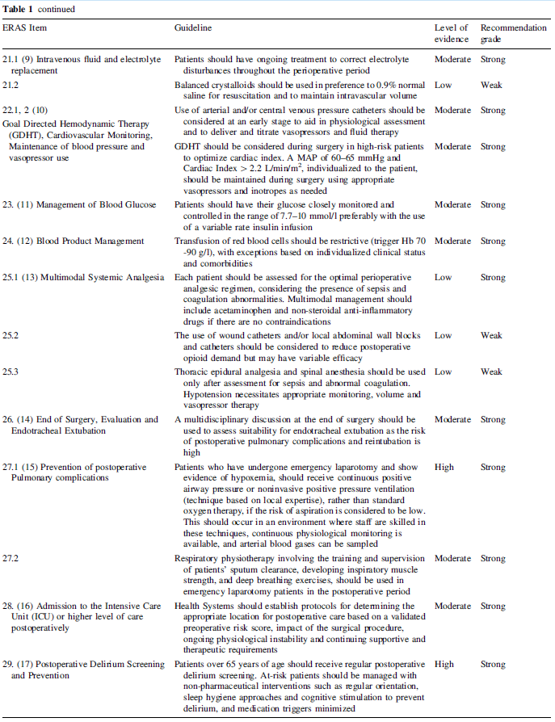

Slide 28
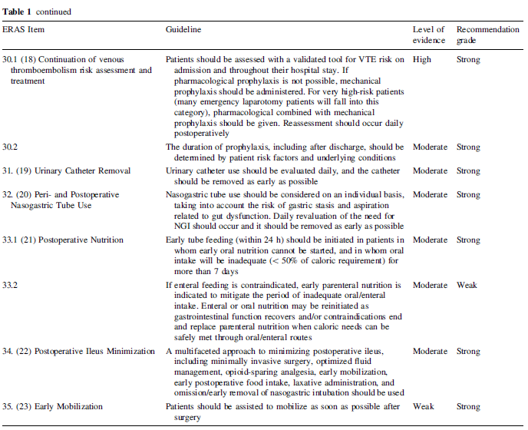

Slide 29
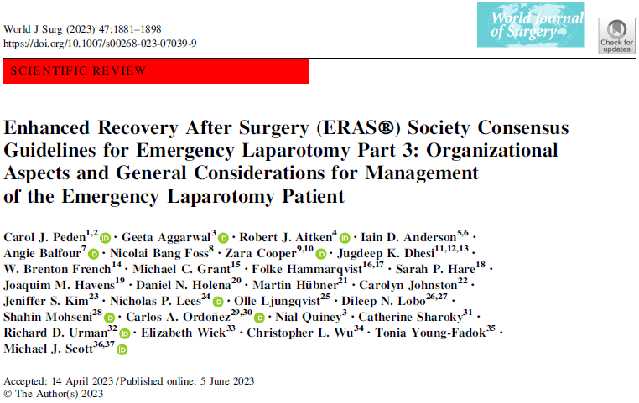
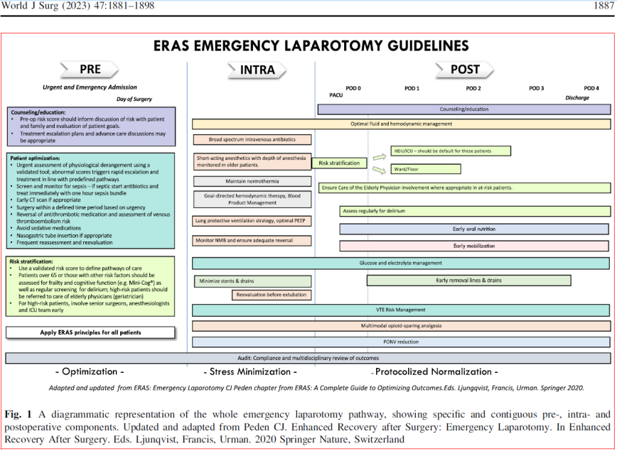

Slide 31
WHAT ABOUT TRAUMA SETTING?

Slide 32
This was a single-center, prospective, RCT conduced in the Division of Trauma Surgery and
Critical Care of a level I trauma center of India between June 2019 and October 2020.
60 randomized patients :
30 ERAS;
30 standard care.
Notes:
32

Slide 33
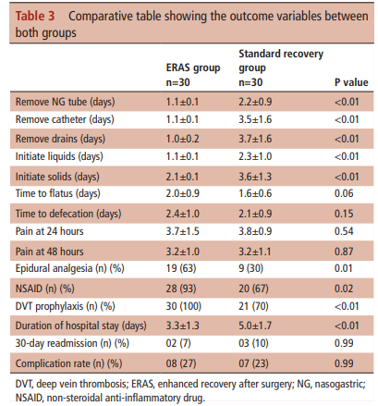
“Limitation of our study was thatwe had stringent inclusion and exclusion criteria, as it was the first RCT for ERAS in trauma”
Patient enrollmet:
All acutely injuried patients;
Age group of 16-65 years;
ASA I-II.
Notes:
33

Slide 34
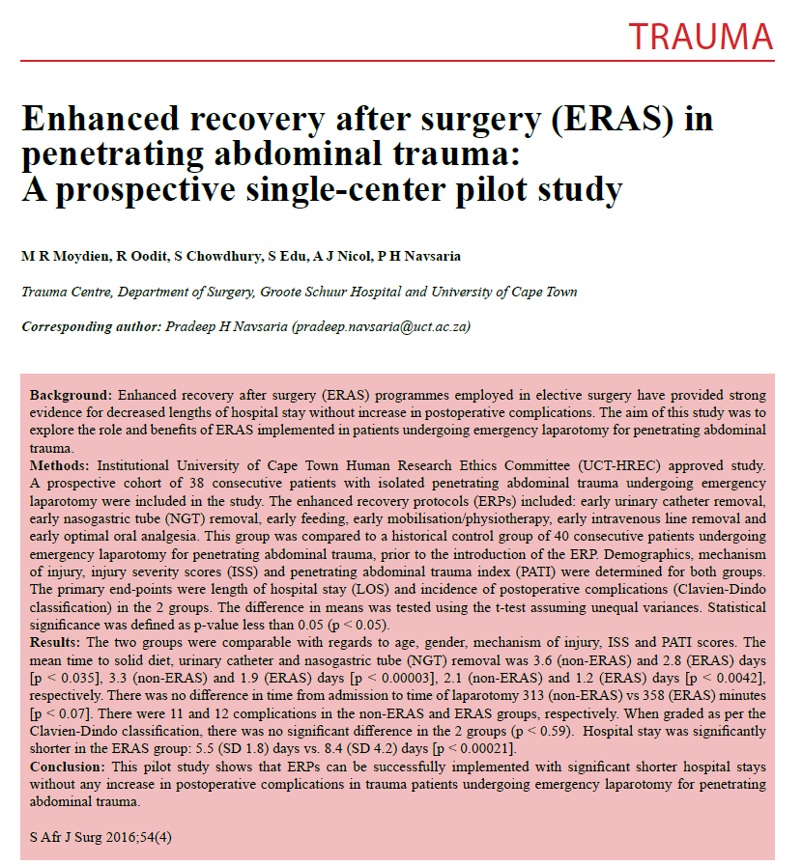
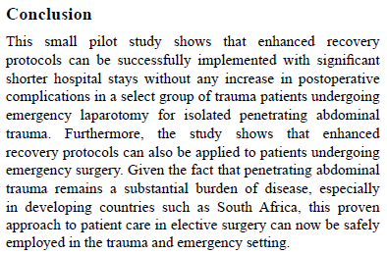
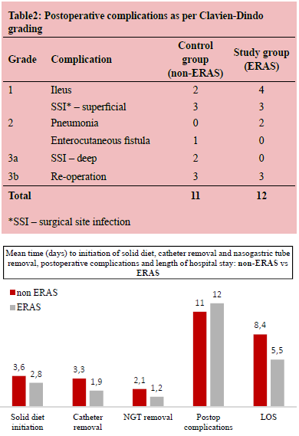

Slide 35
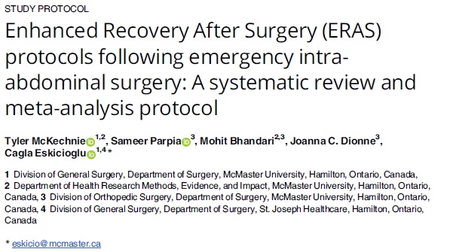
PERSPECTIVES…

Slide 36
ERAS IN TRAUMA AND EMERGENCY SURGERY:
IS IT FEASIBLE?
Dott. Marco Scatizzi
Direttore S.O.C. Chirurgia Generale
Ospedale S. Maria Annunziata e
Ospedale Serristori
Firenze - USL Toscana Centro

